Slide 1

Clover Business understanding Queries

Slide 2
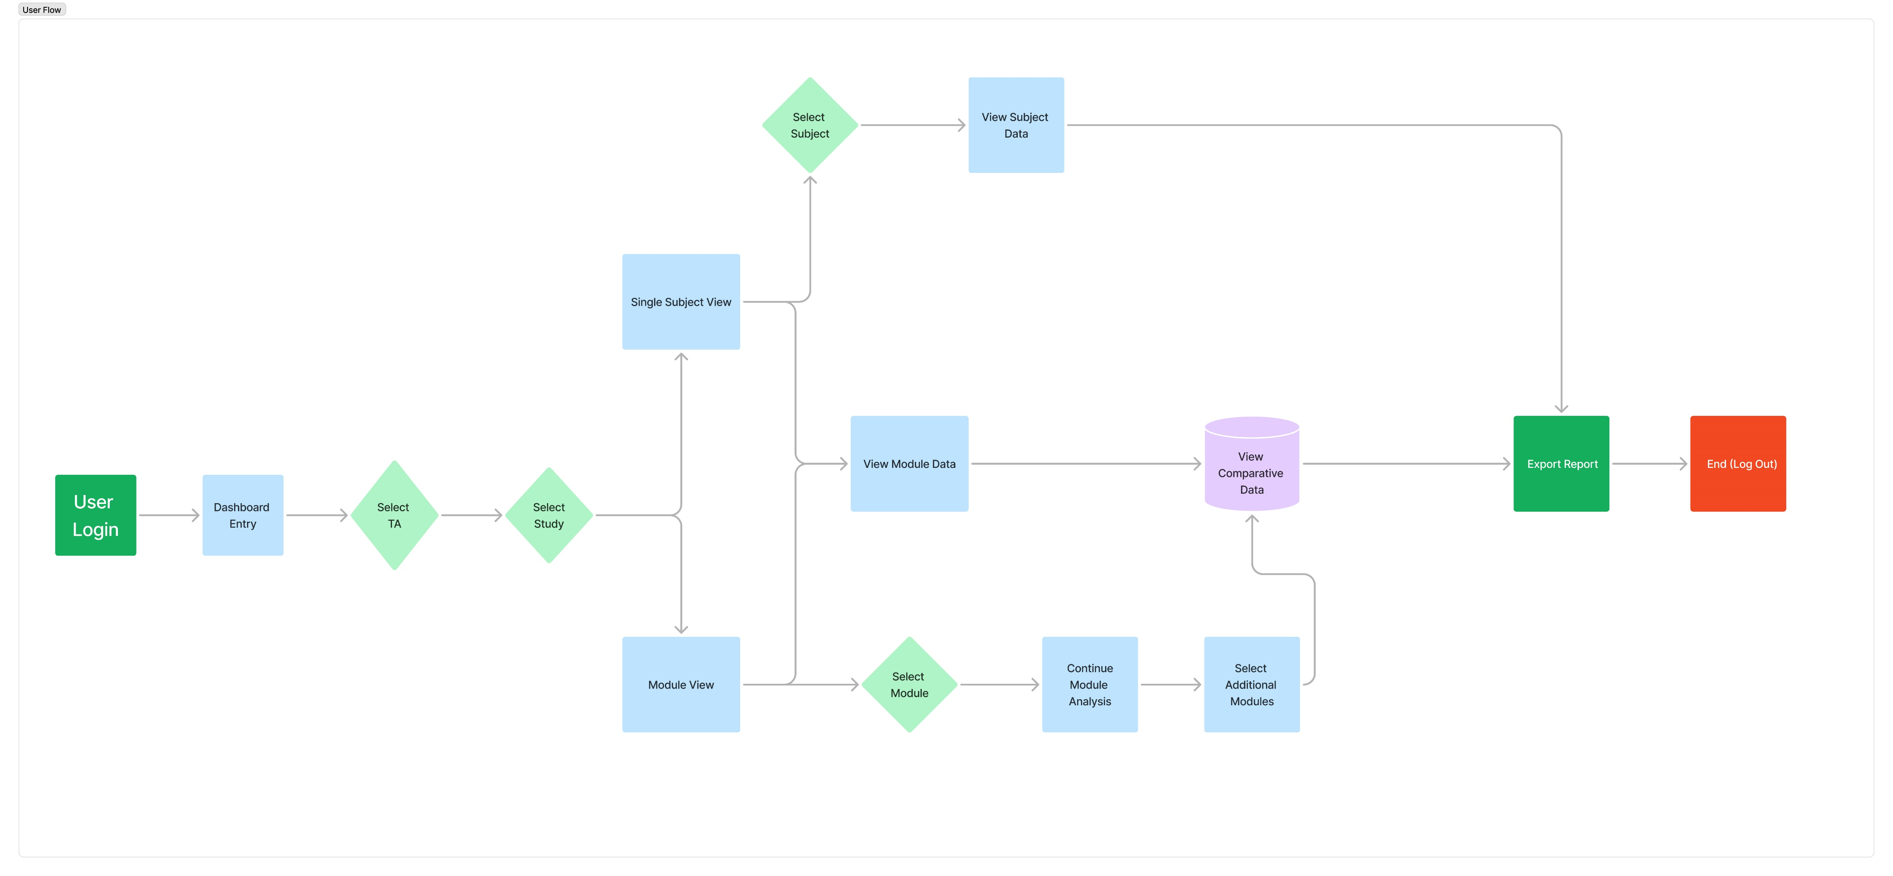
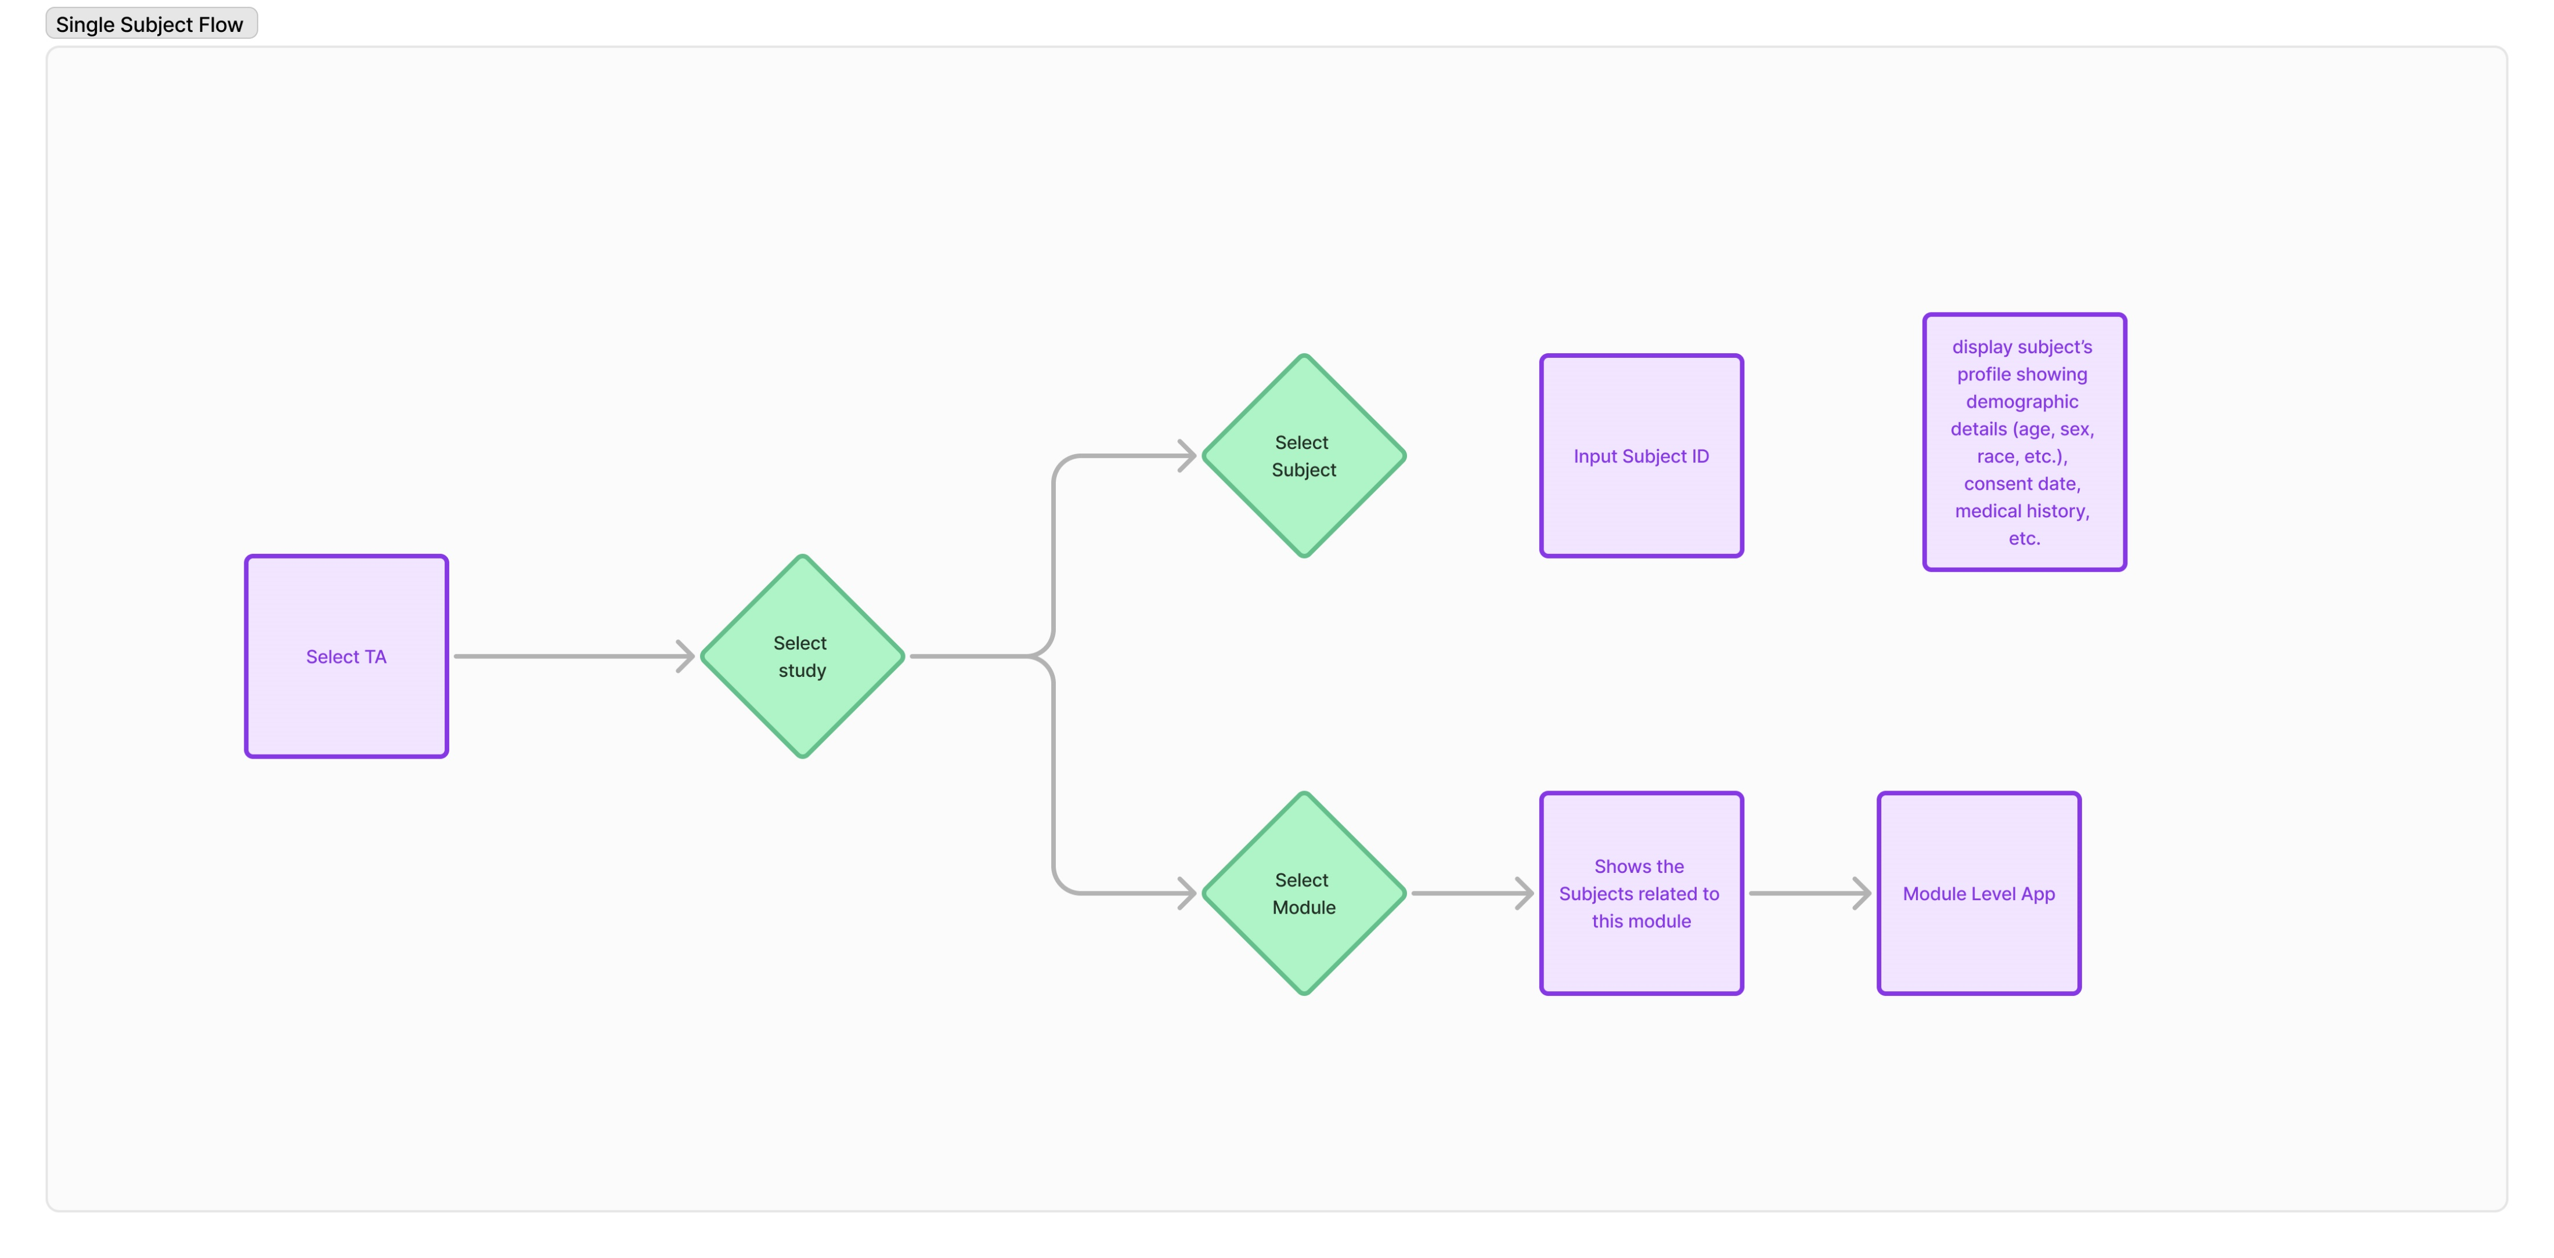
Single Subject User Flow

Slide 3
Single Subject Queries
Would users find it more convenient to select the subject ID using a dropdown menu or a text box for input?
What filtering options should be available for users to interact with and slice and dice the data on both the patient-level page and the module-level page? (any preferred info and filters)
What detailed information should be presented when a user selects a subject?
Should dosing records, Randomization dates, and Discontinuation Information be integrated into the profile/subject view?
Do we want to have an aspect where we capture a user's search patterns to make the tool more intelligent?
If yes, then what factors should be the most important to track, so that the tool can help users to repeat the previous searches efficiently?
Would we like to Save the search/analysis results obtained by the user in any form? (in the tool itself or on any kind of image/ppt)
Should we design different pages or views based on user roles, such as separate sections for MDs focused on study and data relevant to them and SDs with their specific study and data needs?
What type of data source are we using for this tool?
Are there any considerations or plans for future enhancements to this tool on the aspects of tabs and flows getting added?

